Slide 1
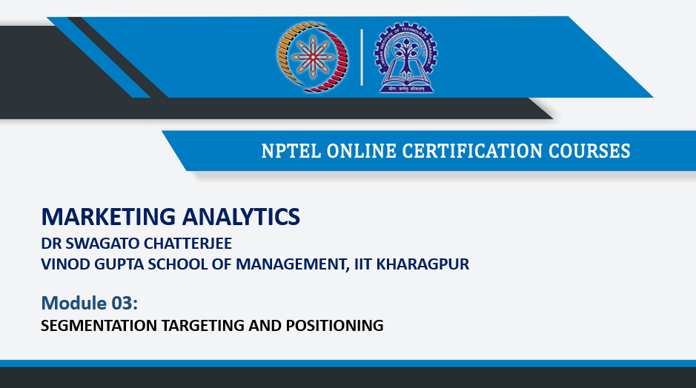

Slide 2
Steps of Segmentation and Targeting
Behavior of Consumer: Factor Analysis
Creating customer segments: Cluster Analysis
Defining the segments
Using demographics to create targeting mechanism: Logistic Regression / LDA
Targeting

Slide 3
Different methods of customer segmentation
Hierarchical clustering
Ward’s Method
K-mean
Model based

Slide 4
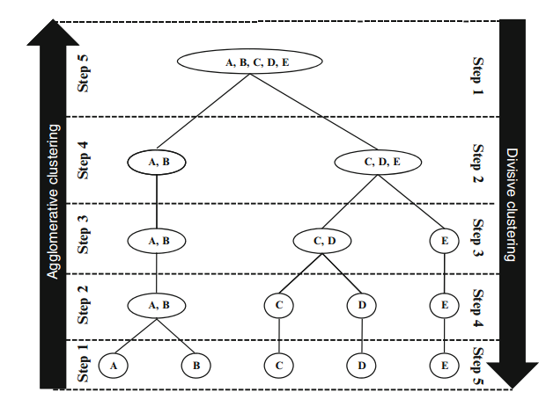
Hierarchical clustering

Slide 5
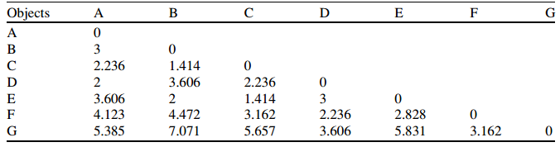
Hierarchical clustering
Single linkage
Complete linkage
Average linkage
Centroid linkage
Customers | Brand awareness | Price sensitivity
A | 3 | 7
B | 6 | 7
C | 5 | 6
D | 3 | 5
E | 6 | 5
F | 4 | 3
G | 1 | 2

Slide 6
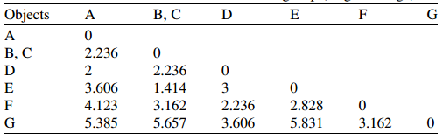
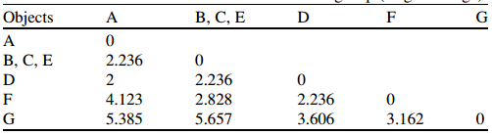
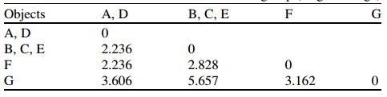



Slide 7
Clusters | Dist
6 | 1.414
5 | 1.414
4 | 2
3 | 2.236
2 | 2.236
Please do the exercise using complete linkage algorithm.

Slide 8



Ward’s method
Agglomerative clustering
Does not consider distance matrix
Most applicable for quantitative variables
Gives almost equal sized clusters if there is no outliers

Slide 9
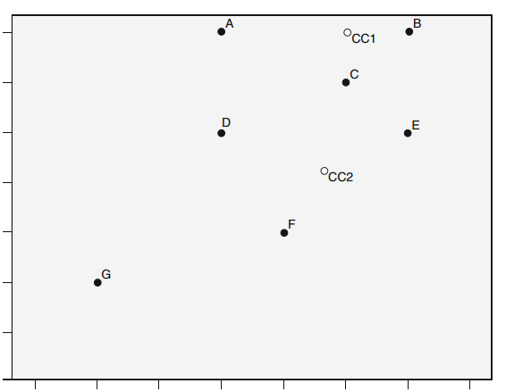
K-Mean
With in cluster variation is minimized

Slide 10
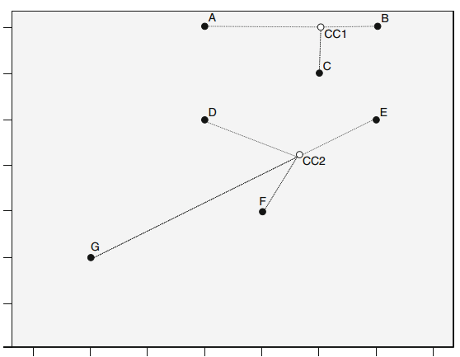
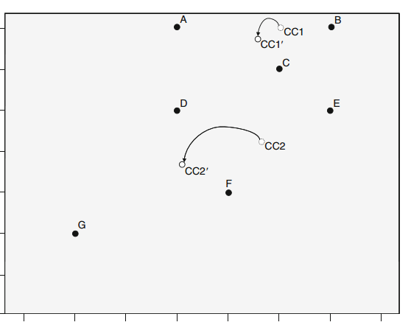
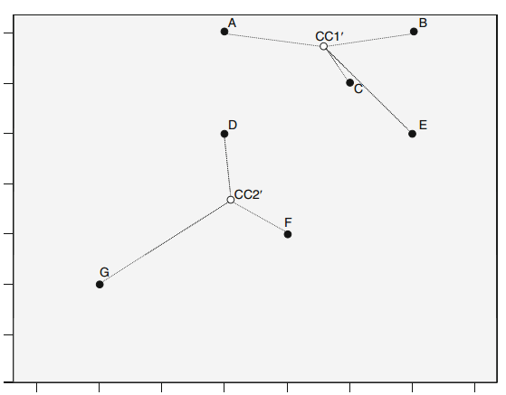

Slide 11
Thank You

